Slide 1
Making a Statement
Cover Letters and Research, Teaching, and Diversity Statements

Slide 2
Peer Review of Statements
https://app.perusall.com/home
Course code: PRITCHARD-D843V

Slide 3
Cover letter
What makes you especially well-suited for the position?
Provides a roadmap for the rest of your application package.

Slide 4
Cover letter - Tips
Highlight what makes you a good match
Qualifications in the advertisement
Learn about the department/institution/company
If contact info is provided, ask!
Match body of the letter to position.
Don’t just repeat your CV.
Present a story of who you will be.
Express positivity but keep it genuine.
Address it to search committee chair, if possible.
Include addresses (yours and theirs) and the date
Make sure it reads well.
Keep it brief (1-2 pages)

Slide 5
Cover Letter - Layout
From University of California, San Francisco (for faculty research positions):
Paragraph 1: What is the position that you are applying for? What do you currently do and where? You can also include here information about how you found the position.
Paragraph 2: What is your expertise? What have you accomplished and who have you worked with? Make sure to highlight anything that makes you especially well suited for the position.
Paragraph 3: What is your research vision? How does it fit with the position?
Paragraph 4: How else will you contribute to the department? Teaching experience and interests, community engagement, diversity and inclusion-related efforts.
Paragraph 5: Express enthusiasm for the position and bring to a decisive close.

Slide 6
Teaching Philosophy
Demonstrate your commitment to teaching.
What motivates you to teach?
Key for both research and teaching oriented institutions.
Do no harm.

Slide 7
Teaching Philosophy - Tips
Tailor the statement to the institution.
E.g. What courses do they offer that you would like to teach? What new courses could you offer them?
Demonstrate a willingness to learn and change, and how you’ve already developed your skills.
Integrate teaching statements with other statements (e.g., research interests; diversity statements).
Teaching outside the classroom (e.g., mentoring, research experiences).
Teaching portfolios (student-surveys, comments)
Highlight online teaching experience.
Draw on your own experiences as a student.
Keep it short (≤ 2 pages).

Slide 8
Diversity Statement
Demonstrate how your skills and experiences have aided (or will allow you to aid) institutional efforts to promote diversity, equity, and inclusion.

Slide 9
Diversity Statement - Tips
Tell your story.
“If you have overcome obstacles to get to where you are, point those out. If, in contrast, you are privileged, acknowledge that … Either way, use your story to explain how you can empathize with students who confront challenges on their way to achieving their educational goals.” – Dr. Tanya Golash-Boza
Focus on issues related to race, gender, sexual orientation, social class, first-generation college students.
Keep in mind legislative definitions of diversity.
Consider more than just student diversity (e.g., diversity at the faculty or departmental level).

Slide 10
Diversity Statement - Tips
Discuss past activities and/or programs that you’ve been involved in.
How do you plan to contribute in the future?
Check out the institution’s current programs/efforts.
What new ideas do you have?
Tailor your statement to the institution.
Check their diversity mission statements for language, values, ideas, etc.
Keep it brief (1, maybe 2 pages).

Slide 11
Diversity Statement – Layout
From University of California, Berkeley:
Past experience
How have you become aware of the challenges faced by underrepresented groups?
Past activities
Mentoring, committees, teaching, outreach programs, etc.
Planned activities

Slide 12
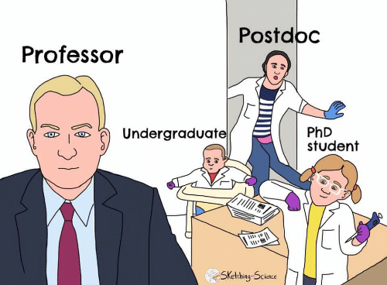
Research Statements
Describe your arc as a researcher.
Common themes to communicate:
Research interests.
Independent thinking.
Professional goals.

Slide 13
RESEARCH Statement - TIPS
Start with an executive summary that addresses:
Why is your research important?
What general approaches do you use or plan to use?
What are your long-term research/professional goals?
Why does this fit with the position? Why do they need someone like you?
Balance specificity with the level of detail. Avoid jargon!

Slide 14
RESEARCH Statement - TIPS
Demonstrate independence as a researcher.
Address plans for grants; highlight resources you can bring.
Make connections with current research at the institution.
Get your audience excited!!
Include figures where they may be useful.
Keep the layout simple.
Keep it brief (2-4 pages).
Hone the writing.

Slide 15
References
Austin, J. (2002, July 26). Writing a research plan. Science. https://www.science.org/content/article/writing-research-plan-rev2
Austin, R. N. (2006, April 14). Writing the teaching statement. Science. https://www.science.org/content/article/writing-teaching-statement-rev2
Borchardt, J. K. (2014, August 6). Writing a winning cover letter. Science. https://www.science.org/careers/2014/08/writing-winning-cover-letter
Golash-Boza, T. (2016, June 10). The effective diversity statement. Inside Higher Ed. https://www.insidehighered.com/advice/2016/06/10/how-write-effective-diversity-statement-essay
University of California Berkeley, Office for Faculty Equity & Welfare. (n.d.). Guidelines for applicants writing statements. https://ofew.berkeley.edu/guidelines-applicants-writing-statements
University of California, San Francisco, Office of Career and Professional Development. (n.d.). Sample materials for faculty positions. https://career.ucsf.edu/phds/academic-careers/academic-samples#Develop-your-research-teaching-and-diversity-statements

Slide 16
See what has worked for others
https://github.com/RILAB/statements/tree/master/job_applications

Slide 17
Open Q & A

